Slide 1
refined content, maybe pare it down
getting their feedback
live polling at the beginning of the session
go through york's stuff - schedule a meeting for later next week or week after
hone it in, and cut

Slide 2
Building Blocks of Blockchain
Hyland Hy-Tech Camp

Slide 3
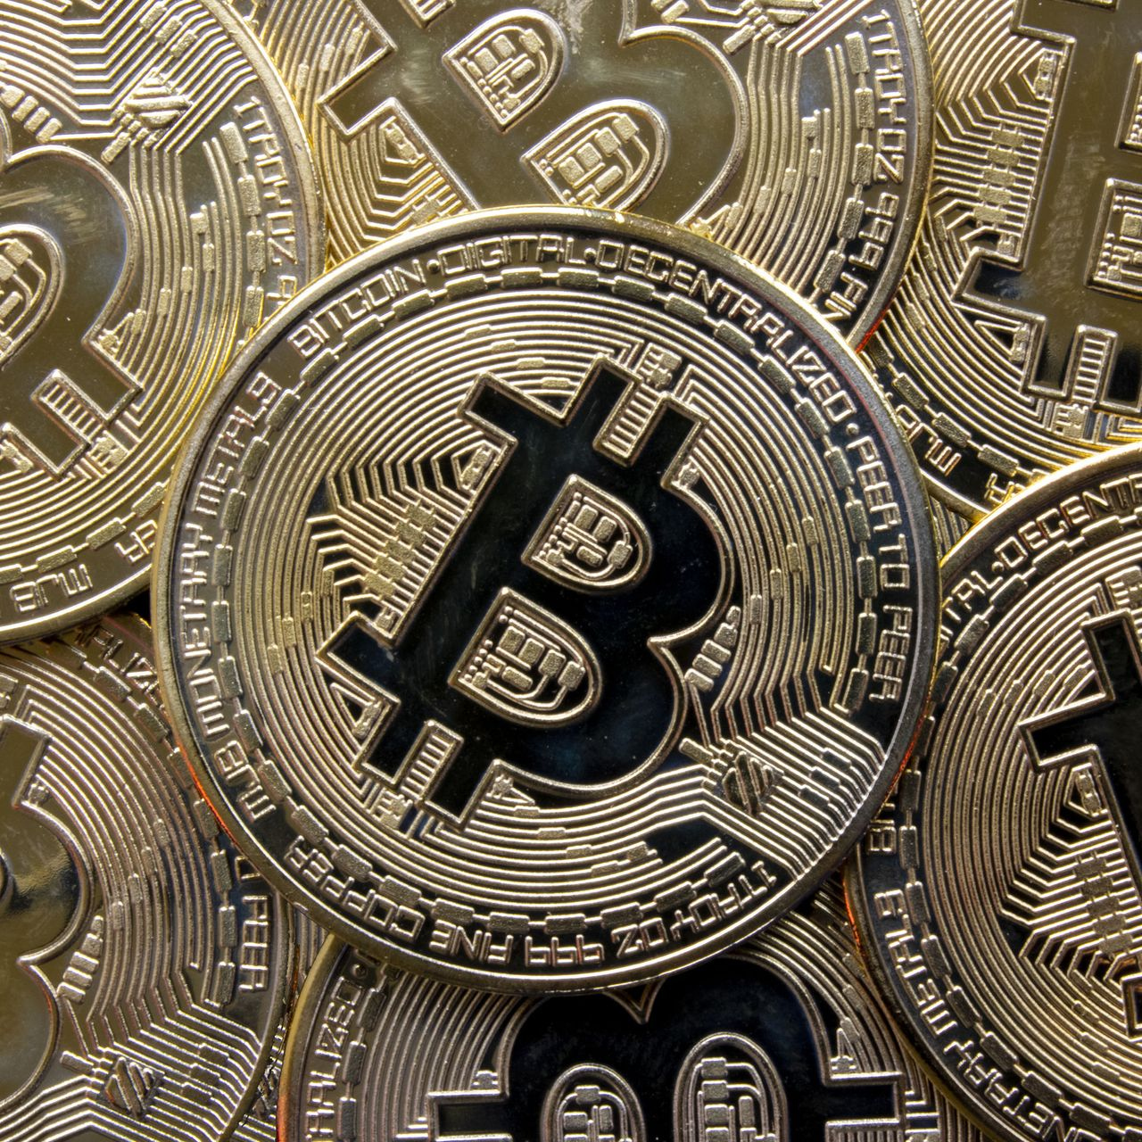
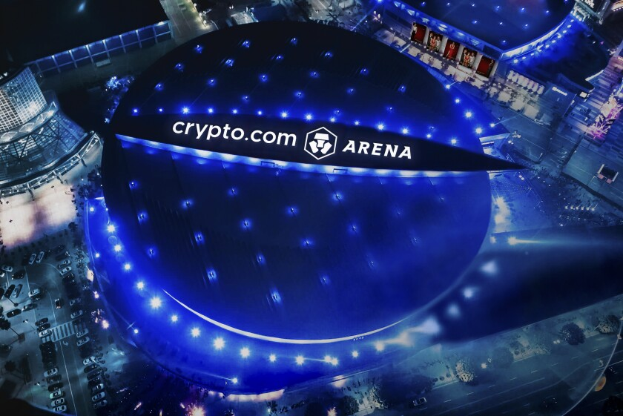
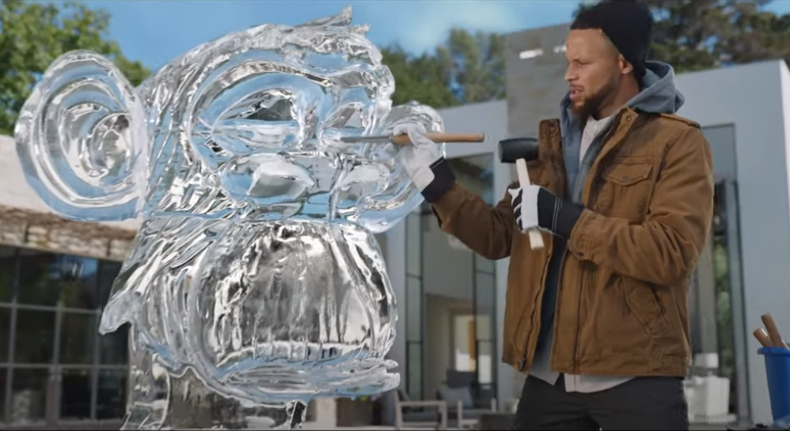

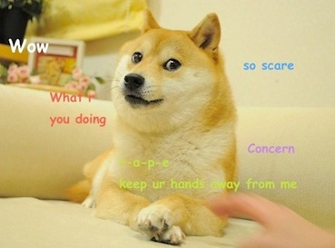
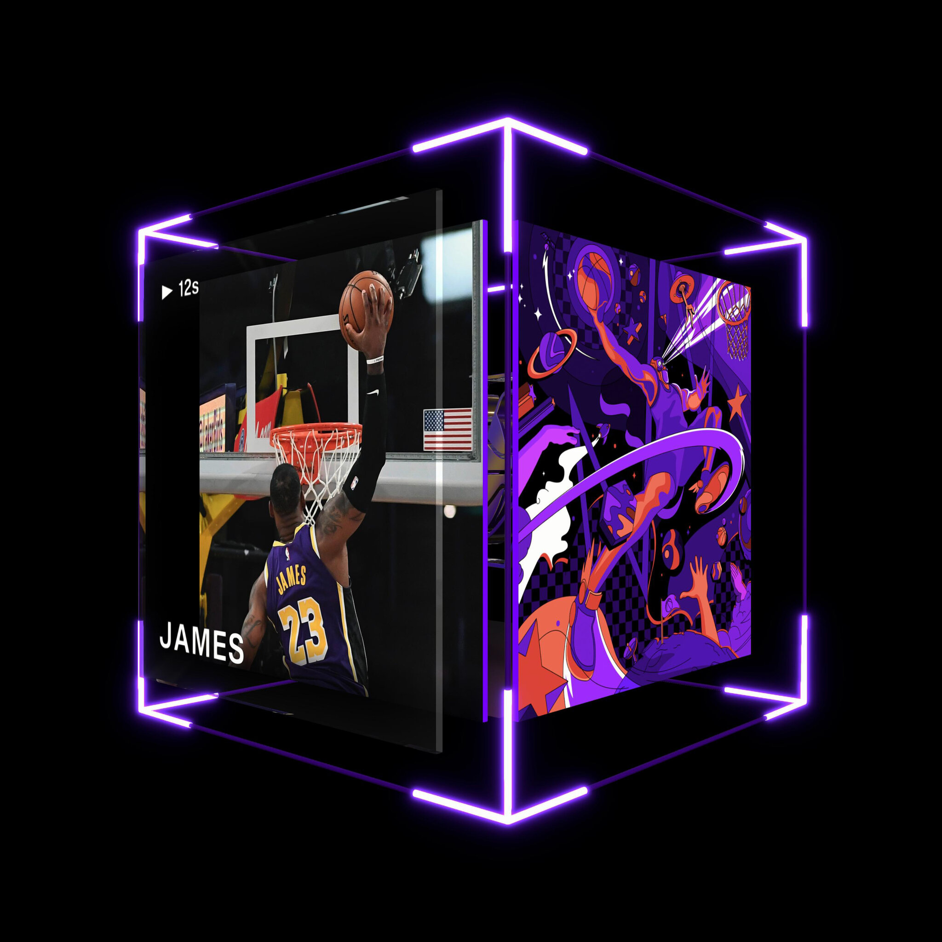
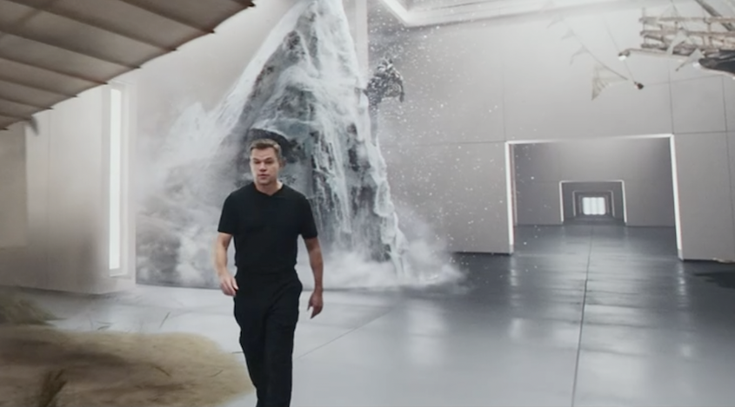
Cultural Perceptions
Notes:
Poll the room to see how many students have heard of blockchain, bitcoin, cryptocurrency, NFTs
Ask the students if they know what these things are
Bitcoin is a Cryptocurrency – you might have heard about it as an investment.
Ask if students recognize this shiba inu – it’s the mascot of a memecoin called Dogecoin.
Does anyone know where the Lakers play? They used to play at the Staples Center, but the name recently changed to crypto.com.
You may have seen the Matt Damon super bowl ad for the same company – it’s a Cryptocurrency exchange.
Maybe you’ve seen this FTX ad featuring Steph Curry – or maybe you recognize the ice sculpture he’s building (Bored Ape Yacht Club NFTs)
You may have seen pictures like this pixelated person – they are NFTs, basically digital assets than can be owned and traded.
Another example of NFTs is NBA Top Shot – basically virtual trading cards

Slide 4
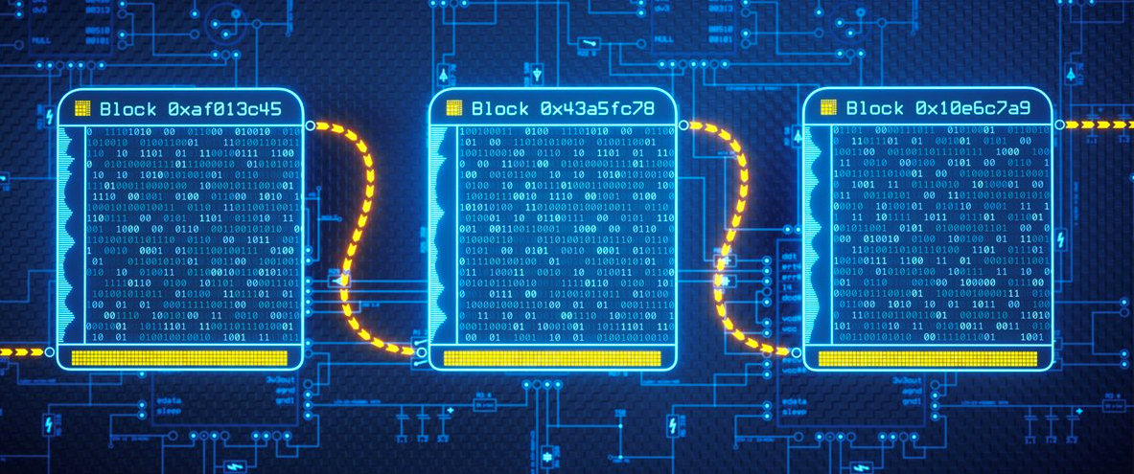
Blockchain: The Technology Behind It All
A blockchain is an immutable ledger for recording transactions, tracking assets, and building trust
It is the technology behind cryptocurrencies and NFTs
Although it originated with Bitcoin, its applications are much farther reaching
Notes:
Go over the definition of blockchain – this will be covered more in-depth later on, so no need to over-explain
Biggest thing is that blockchain is the underlying technology that makes things like cryptocurrency and NFTs possible
It started with Bitcoin (more on that later), but there is a lot more that it can do

Slide 5
The History of Blockchain
Where does it come from?
Notes:
Get into some of the history of blockchain – if students remember from the previous slide, it all started with bitcoin

Slide 6
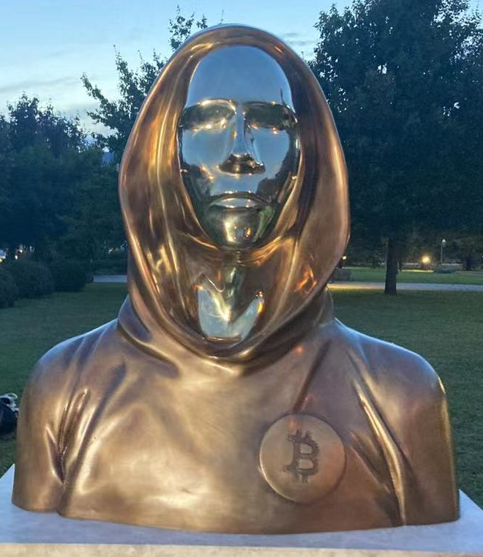
Bitcoin & Satoshi Nakamoto
Jan 4, 2008 – domain name registered
Oct 31, 2008 – white paper released
Jan 3, 2009 – genesis block
Going towards open source, community-driven development
What is a cryptocurrency?
What is the true value of a bitcoin?
Who is Satoshi Nakamoto?
Notes:
Bitcoin
Bitcoin is a cryptocurrency – a digital currency designed to work as a medium of exchange through a computer network that is not reliant on any central authority, such as a government or bank, to uphold or maintain it.
Created by a mysterious figure named Satoshi Nakamoto – could be

Slide 7
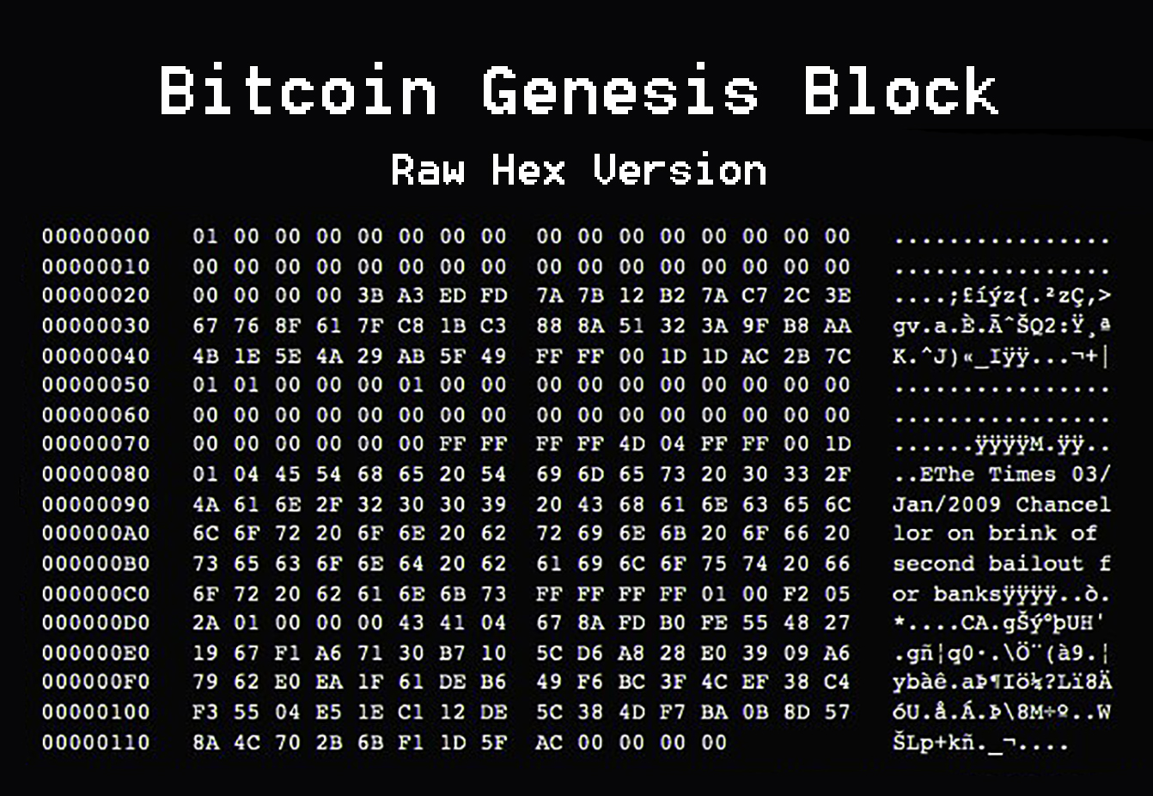
Bitcoin & Satoshi Nakamoto
Who is Satoshi Nakamoto?

Slide 8
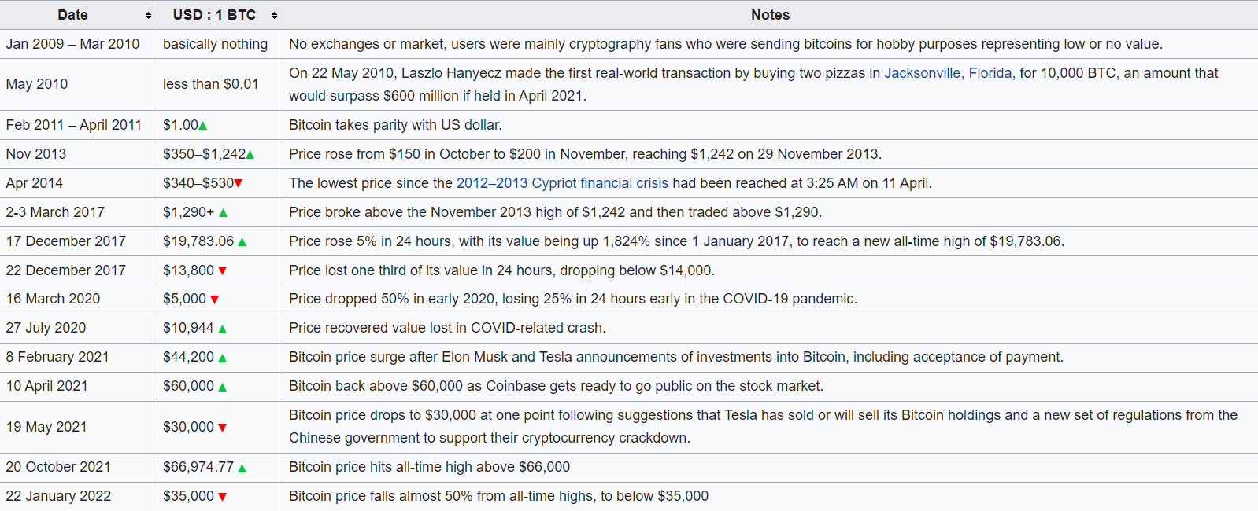
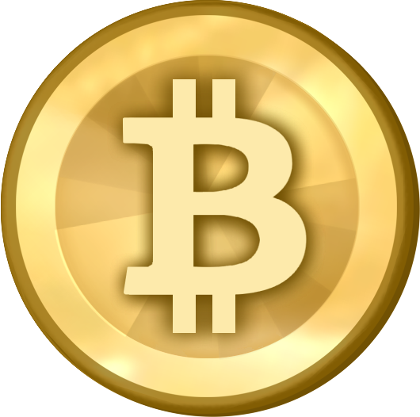
Bitcoin Value History
Date
Jan 2009-Mar 2010
Value in $
basically nothing
Notes
No exchanges or market, users were mainly cryptography fans who were sending bitcoins for hobby purposes representing low or no value.
Notes:
https://en.wikipedia.org/wiki/History_of_bitcoin
Talk about the growth of bitcoin and how blockchain technology grew along with it

Slide 9
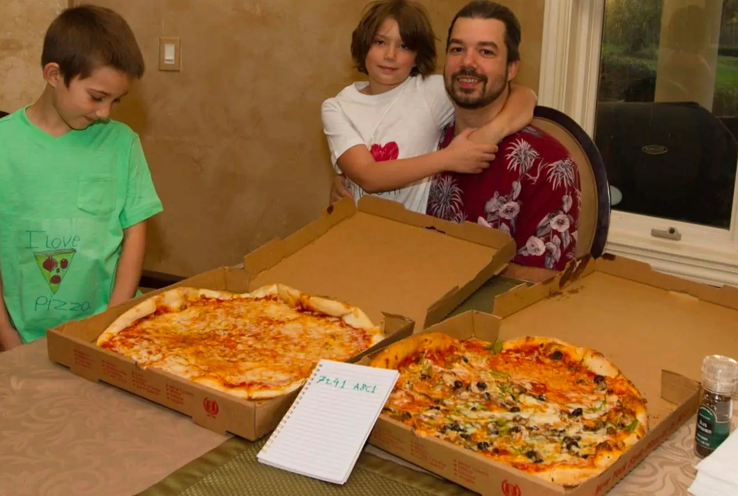
Bitcoin Value History
Date Value in $
May 22, 2010 Less than $0.01
Notes
Laszlo Hanyecz made the first real-world transaction by buying two pizzas in Jacksonville, Florida, for 10,000 BTC, an amount that would surpass $680 million if held in November 2021.
Notes:
https://en.wikipedia.org/wiki/History_of_bitcoin

Slide 10
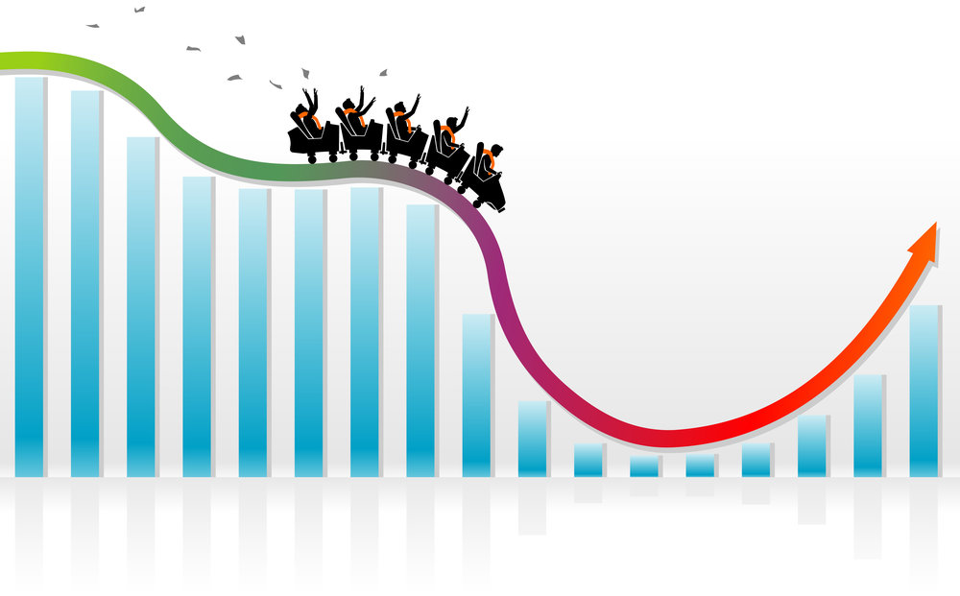
Bitcoin Value History
Date
Nov 2013-Present
Value in $
Extremely Volatile
Notes
Financial Crisis
COVID-19
Elon Musk/Tesla
Coinbase
Other Factors?
Notes:
https://en.wikipedia.org/wiki/History_of_bitcoin

Slide 11
Why Create Blockchain?
multiple parties without trust? blockchain ensures one single source of truth
Decentralization
Trustless
Minimizes problem of double spending
As of 2017, 1.7 billion adults in the world are unbanked
Notes:
https://globalfindex.worldbank.org/sites/globalfindex/files/chapters/2017%20Findex%20full%20report_chapter2.pdf
The first implemented example of a blockchain was used as a public ledger for Bitcoin
A form of cash that could be sent peer-to-peer without the need for a central bank or other authority to operate and maintain the ledger, much as how physical cash can be.
The implementation of the blockchain within bitcoin made it the first digital currency to solve the double-spending problem without the need of a trusted authority or central server.
Peer-to-peer, trustless transactions in immutable digital ledgers
Decentralized
https://www.youtube.com/watch?v=bBC-nXj3Ng4

Slide 12
Blockchain Beyond Bitcoin
Variety of Cryptocurrencies
dApps
NFTs
DeFi
Play-to-Earn Systems (emerging use case)
Supply chain management
Song lyrics – creative
Building out trust networks + ownership – avoid plagiarism
Opensea – mint your own nft art https://opensea.io/
https://www.nytimes.com/2021/03/26/technology/nft-sale.html

Slide 13
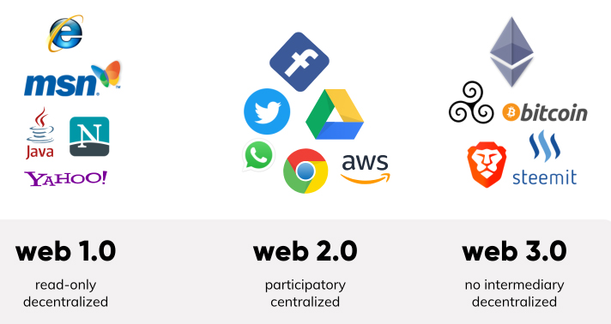
? Blockchain & The Web
Web 1.0, Web 2.0, Web 3.0 (value, identity, persistence)
Visualizations
Acceleration of technology, the speed at which things change
How impactful is the internet
https://www.martechalliance.com/stories/whats-the-difference-between-web-1.0-web-2.0-and-web-3.0

Slide 14
Blockchain Architecture
How does a blockchain actually work?
Notes:
Diagram using people in the room, everyone is a node – interactive thing, drop in the use of smart contracts, cryptocurrency

Slide 15
Basics
A ledger
Transactions on blocks, everyone in the network has a copy of the chain, cannot change previous blocks
Immutable
Decentralized
Trustless
Notes:
https://www.youtube.com/watch?v=bBC-nXj3Ng4
https://jis-eurasipjournals.springeropen.com/articles/10.1186/s13635-019-0085-3

Slide 16
Cryptography
SHA256 Hash – Cryptographic Hash Function
Public/Private Key Pairs for digital signatures
Nonces

Slide 17
Mining Cryptocurrency
What is mining
Proof of work
Miners = Block Creators who receive a Block Reward
Bitcoin as an example – evolution of difficulty over time to maintain 1 block per 10 minutes, also block reward has been updated over time to ensure there is only a limited number of bitcoin over time – economically,
Hash starting with a bunch of 0s (like 76) – one in 75 sextillion chance
Block Explorer https://www.blockchain.com/btc/blocks?page=1 (show them at the end maybe)
https://www.blockchain.com/btc/block/1
https://www.blockchain.com/charts#mining
Notes:
https://bitcoin.stackexchange.com/questions/1781/nonce-size-will-it-always-be-big-enough
Difficulty: https://bitcoin.stackexchange.com/questions/16687/solo-mining-just-for-luck-realistic

Slide 18
Interactive Demo
https://andersbrownworth.com/blockchain/
Notes:
Finding leading 0s, like checking your work in math

Slide 19
Ethereum & Smart Contracts
How can you develop a blockchain app?

Slide 20
Ethereum v. Bitcoin
What is Ethereum?
What makes it different from bitcoin? BTC as a cryptocurrency v. Ethereum as a smart contract platform that’s programmable
Coin in arcade machine to play the game -> smart contract analogy
Microtransactions
Keep it high level
Remix – Ethereum IDE
Cryptozombies can write code for you
Notes:
Different block creation time
Blockchain is not just cryptocurrencies

Slide 21
dApps
What are dApps? Decentralized Apps
What is the purpose?
Examples: token swaps, games, investments
https://ethereum.org/en/dapps/

Slide 22
Smart Contracts & Solidity
Smart contracts are business logic on the blockchain itself
Solidity is a programming language for smart contracts
Transactions cost gas
Why? No mental transactions, more predictable, completely unambiguous (unlike the law)

Slide 23
Blockchain & Society
How does blockchain impact the world?

Slide 24
Controversy: Crypto-Bubble
Wikipedia has stopped taking crypto donations – Extremely risky + inherently predatory
Unregulated market – first type of digital asset… dangerous, but government is thinking about it
“Best place to invest in crypto is in your knowledge.” Technology is not going away, will be leveraged in the infrastructure layers of global computing into the future
Kind of like databases
Notes:
https://finance.yahoo.com/news/extremely-risky-inherently-predatory-wikipedia-110040373.html

Slide 25
Controversy: The Environment
Mozilla has stopped taking crypto donations
Tesla has stopped taking Bitcoin payments (causing the value to plummet)
Ethereum is moving to proof-of-stake https://ethereum.org/en/energy-consumption/
Other types of networks that are more cost effective, different consensus algorithms, many initiatives to make it more environmentally friendly, easier to maintain
Crypto is a bit like the wild west at this point
EU, Singapore making their own networks
Texas – solar plants to do crypto mining
Bitcoin mining – monetize the excess energy on a network, sell bitcoin to monetize creation of the electrical grid. Turn off mining when the network needs the energy. Normalize the network load
Notes:
https://techcrunch.com/2022/01/06/mozilla-foundation-crypto/?guccounter=1&guce_referrer=aHR0cHM6Ly9maW5hbmNlLnlhaG9vLmNvbS9uZXdzL2V4dHJlbWVseS1yaXNreS1pbmhlcmVudGx5LXByZWRhdG9yeS13aWtpcGVkaWEtMTEwMDQwMzczLmh0bWw&guce_referrer_sig=AQAAAH6Sc90lcZaPvLxsYHkWzOHjL6BKzxBIfKjOK6cXTt_1TeGBuLdGus-_Sldwym358vzVc9sCed60iIoJWWIsobsJq6QnATYhCK6uaq4RBJdgch5sykTtBLq7EwhPoAqu0Llz4HDTvGTCL_goH6h3asoutcrWAnhWv7O7WAmBzU_7
https://fortune.com/2021/05/12/bitcoin-plunges-elon-musk-tesla-car-purchases/

Slide 26
Controversy: Crime
Rug pulls
51% attack
Bored ape yacht club hack - https://www.coindesk.com/tech/2022/04/25/at-least-13m-in-nfts-stolen-after-bored-ape-yacht-club-instagram-discord-hacked/
Malware locking – require to pay bitcoin
Incentivizes hackers more, and they can stay pseudo-anonymous
Transparency of Bitcoin – can track every single transaction back to the beginning. Auditability – can see the money when it’s stolen – in perpetuity forever
FBI recovered millions of dollars of bitcoin that was stolen years ago - https://www.wsj.com/articles/how-the-fbi-got-colonial-pipelines-ransom-money-back-11623403981
Notes:
Including rug pulls

Slide 27
Real-World Use Cases
DTO app at Hyland
Uniswap
Hyland customer – government of malta
Blockchain-based hyland credentials for higher ed - https://www.hyland.com/en/platform/product-suite/hyland-credentials/higher-education
Falsifying student transcript is an issue, and this helps with automation

Slide 28
Gartner Hype Cycle

Slide 29
Summary
Wrapping things up

Slide 30
THANK YOU!
WHAT QUESTIONS DO YOU HAVE?

